Slide 1



Slide 2
Our Mission
To Empower families in need to create Christmas experiences for their kids through the generosity of community.

Slide 3
Our Values
The LMCB values
respect for the people we serve
inclusivity for families facing multiple barriers
collaboration with Christmas bureaus and agencies across the lower mainland

Slide 4
Here are how your contributions make a difference across the lower mainland…

Slide 5
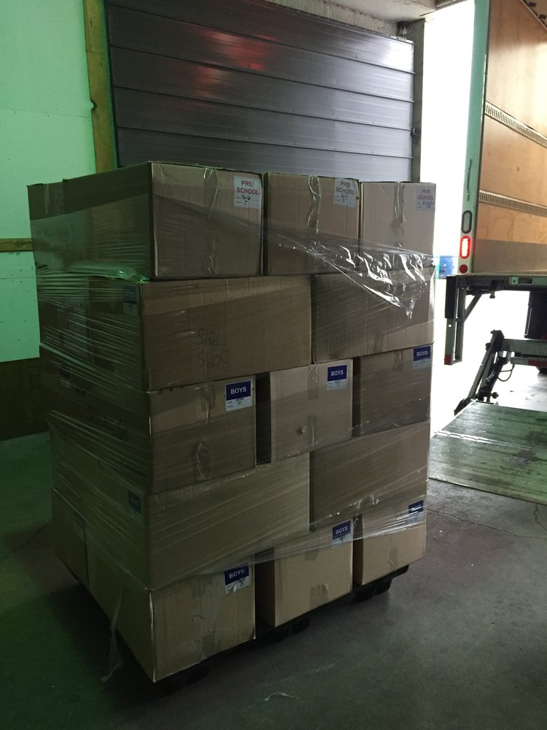
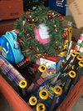
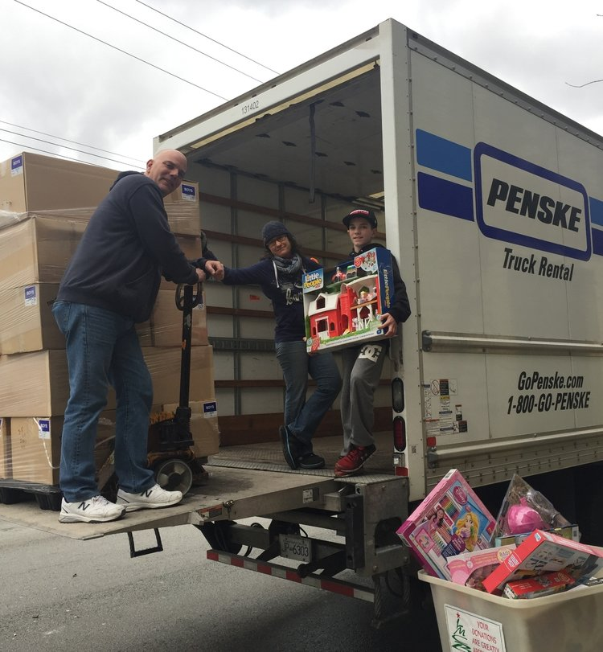
Our Work
Regional Networker & Distributor
Vancouver Christmas Bureau
Toy Store Program
We distribute toy and gift donations to support Christmas Bureaus and other agencies across the lower mainland.
serve our local community in Vancouver by providing assistance to low-income families with kids from 0-18 years of age
we believe that every family should feel the excitement of giving and receiving holiday gifts

Slide 6
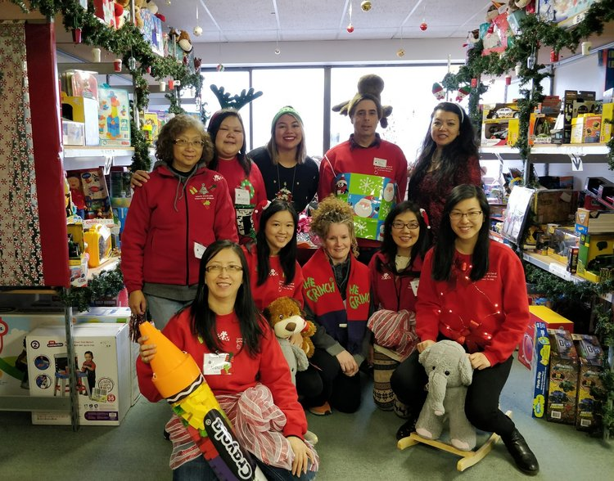
Christmas Toy Store for Families in Need
We set up a pop-up Toy Store for 3 weeks every December and encourage families with low-income or are on assistance to register.
Parents get to personally ‘shop’ through our Toy Store with dignity, selecting gifts for their children
Qualifying Families receive:
A grocery store gift card to purchase items for a warm Christmas meal
Each child (from 0-18 yrs. old) receives:
A primary gift
a new book
a stuffed toy
stocking stuffers
new and gently used clothing

Slide 7
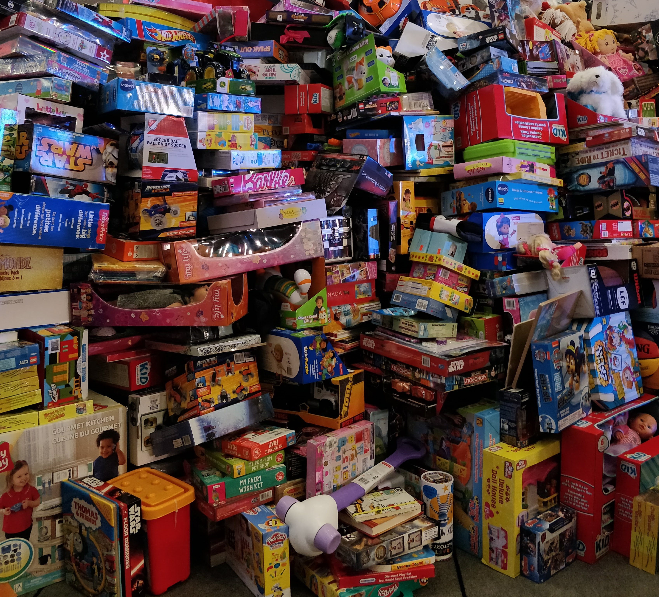
Regional Distributor of Gifts
We have the largest toy warehouse of all the Christmas Bureaus
Every year we ship tens of thousands toys and gifts across the lower mainland

Slide 8

The kindness of supporters like you make our work possible
In 2018
We helped 929 families with children living in Vancouver
Over 20,000 gifts were distributed to 1,933 children in Vancouver
1,309 caregivers were given a total of $63,800 in grocery store gift cards to provide items for a warm Christmas meal for their families
103,000 toys and gifts were shipped to 64 other bureaus and agencies across the lower mainland

Slide 9
You helped make Christmas brighter for so many families!
We hope you will continue to support the LMCB.
Positive holiday experiences can change lives and together we can empower families to create Christmas experiences for their kids with your kindness and generosity.

Slide 10
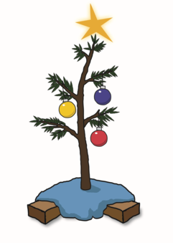


Many thanks from the Lower Mainland Christmas Bureau!
www.lmcb.ca/donate
Music by: https://www.bensound.com/

